Slide 1
Welcome to Azure Defender + Azure Sentinel Better Together! Day 1

Slide 2
A look into Day 1
Kick-Off | 8:00-8:05 | Welcome | Main Call
 | 8:05-8:30 | Security Center + Azure Defender
 | 8:30-8:45 | Demo Walkthrough
Ingest | 8:45-9:00 | Break
 | 9:00-10:00 | Azure Defender Solutions
 | 10:00-11:00 | Activity: Data Lake Design & Security Considerations | Table Group Call
 | 11:00-11:15 | Break
 | 11:15-12:00 | Build Hands-on: Data Integration Part 1 | Table Group Call
Transform | 12:00-1:00 | Break | Main Call
 | 1:00-1:30 | Data Transformations
 | 1:30-2:00 | Activity: Data Engineering Discussion
 | 2:00-3:00 | Build Hands-on: Data Integration Part 2 | Table Group Call
 | 3:00-:15 | Closing | Main Call
Today we will be learning and collaborating across three spaces:
Main call (this meeting)
Table Group channel within the event Team
CloudLabs Learner Portal & Lab environment
Presentation/
Whole Group
Lab
Activity/ Discussion/ Group Work
Announcements

Slide 3
Security Center + Azure Defender

Slide 4
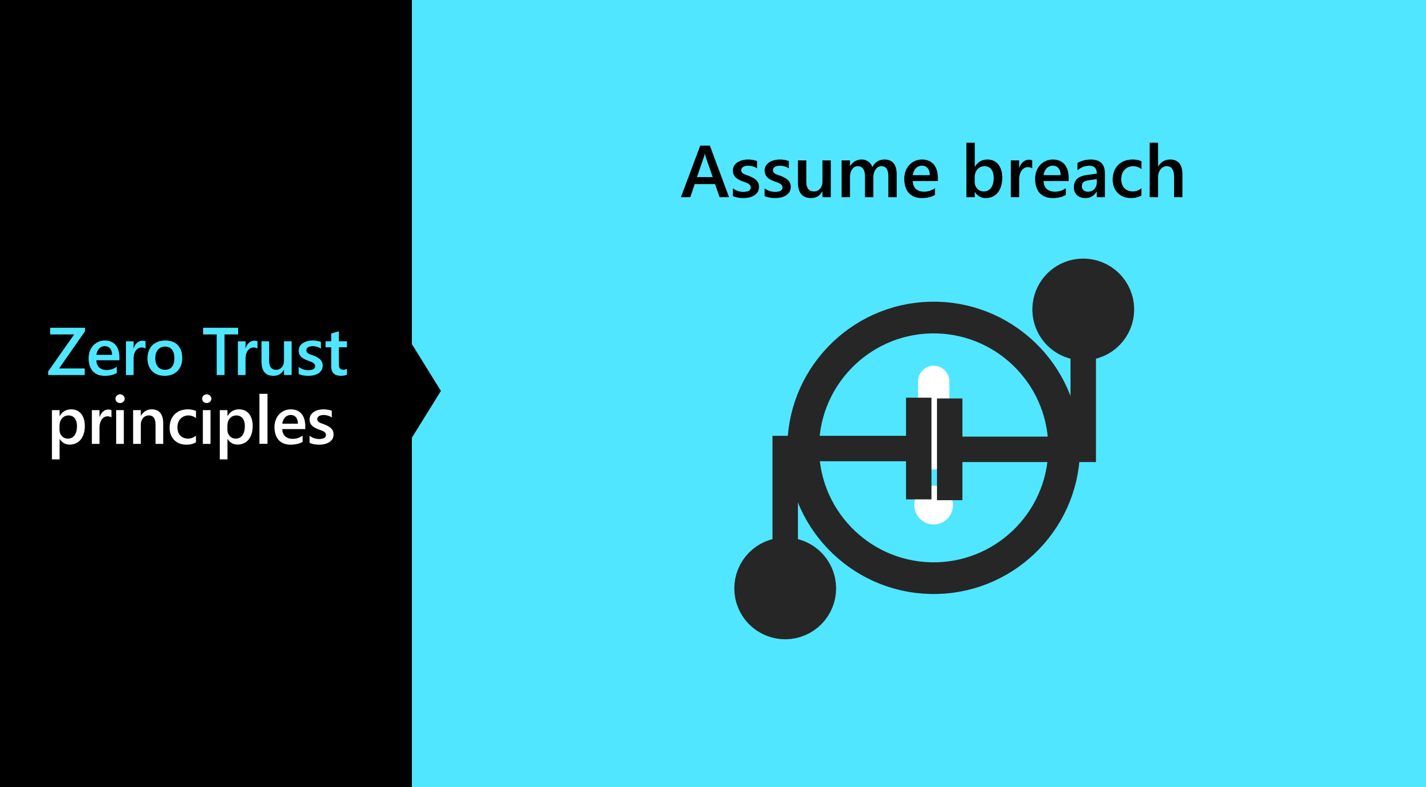

Slide 5

Zero Trust Principles
Verify Explicitly
Use Least Privileged Access
Assume Breach

Slide 6
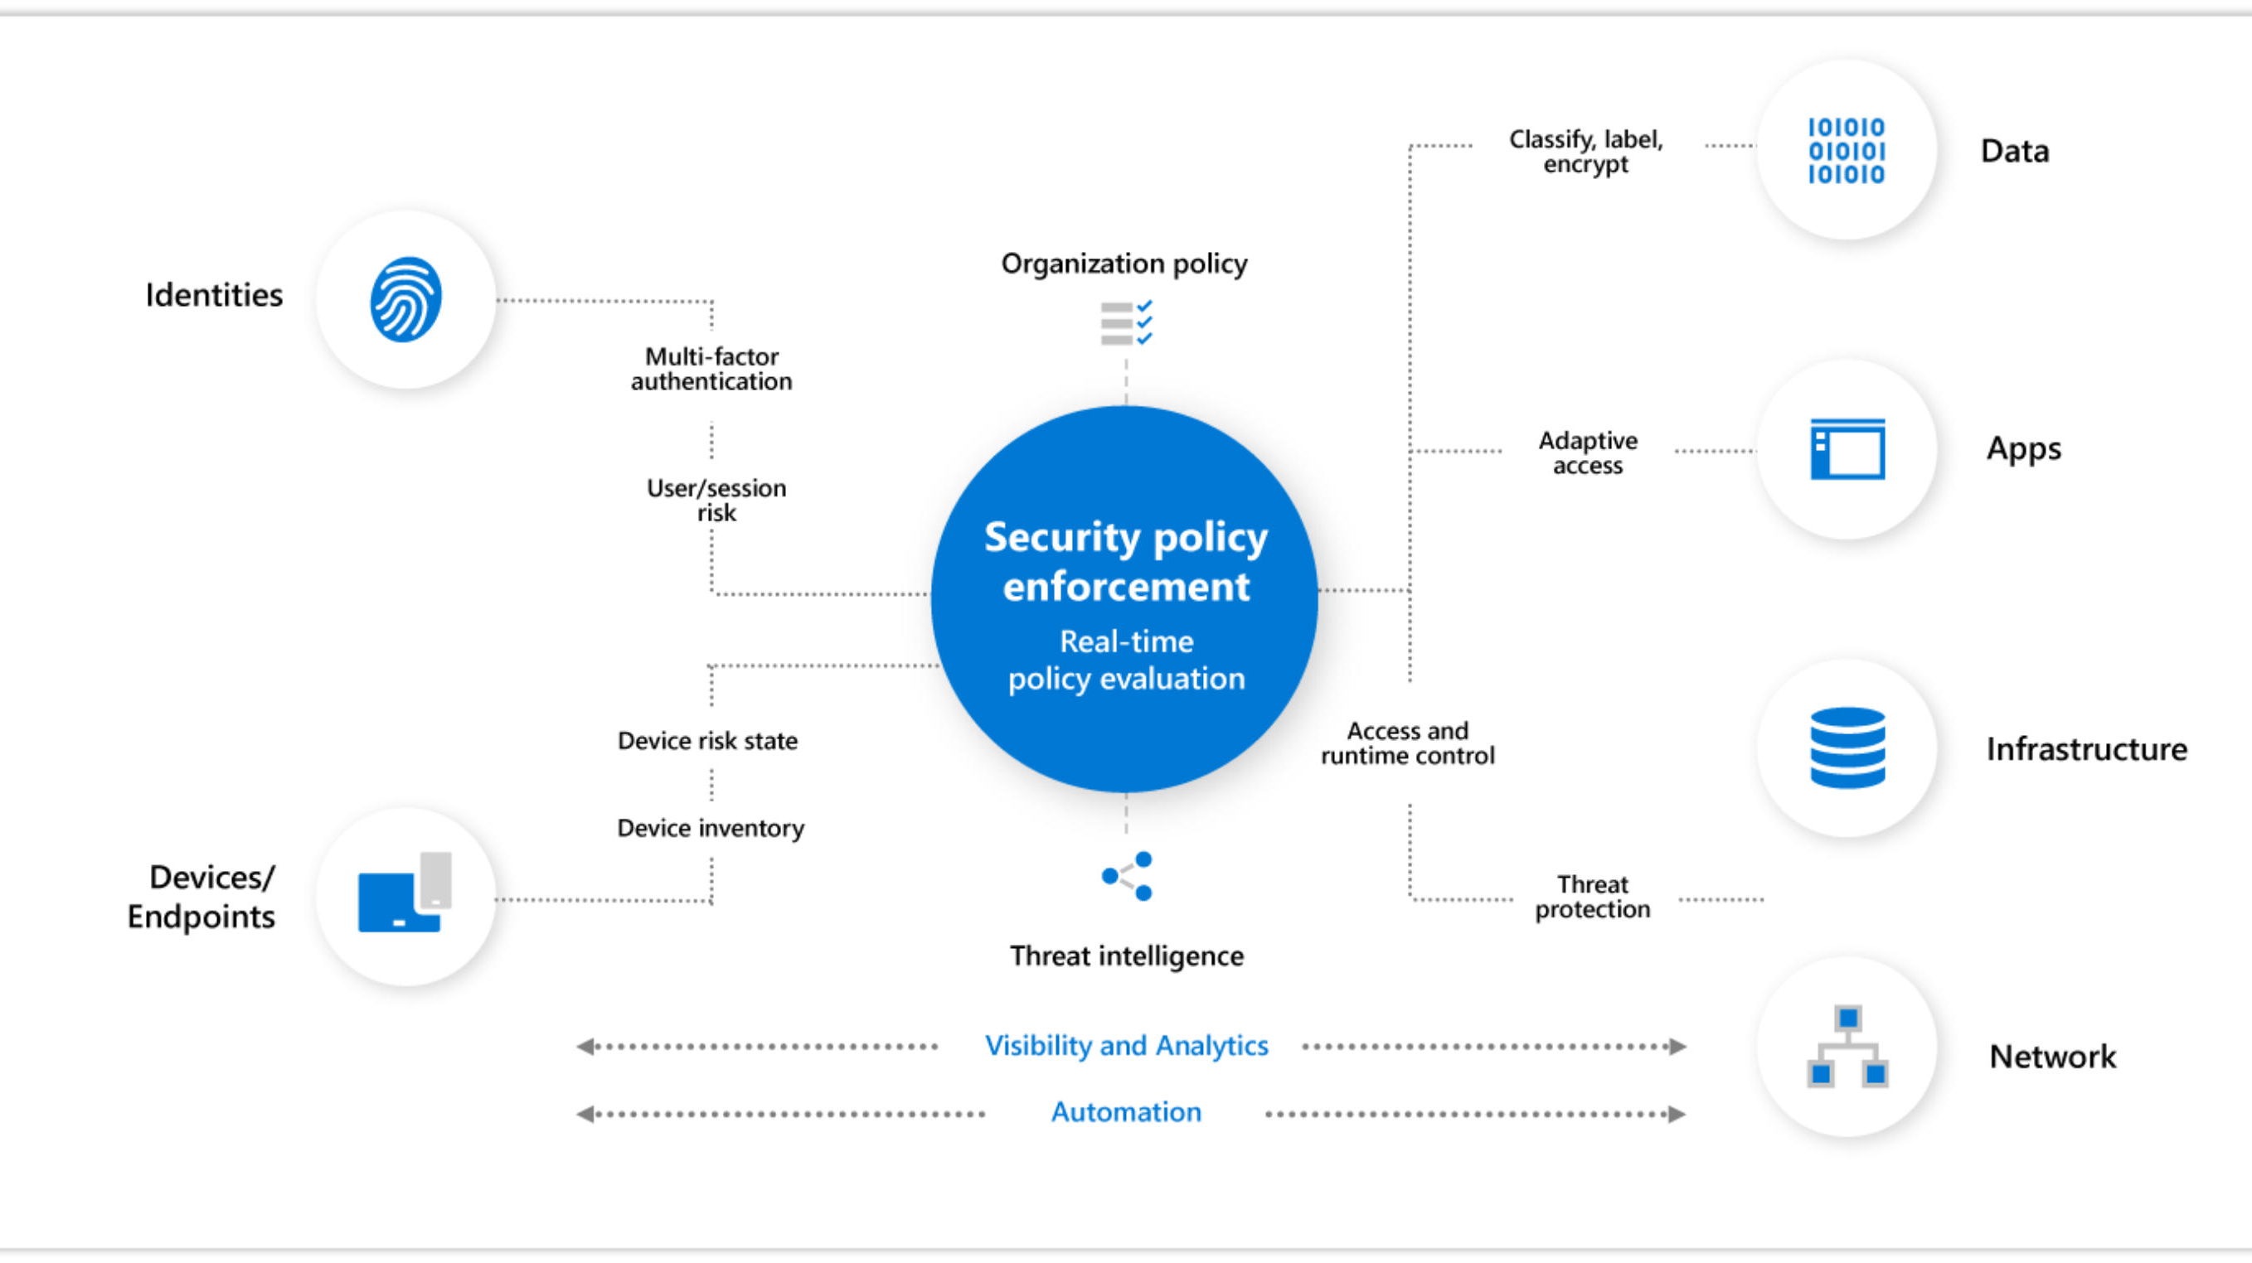

Slide 7

Why Assume Zero Trust?
Mobile Access
Cloud Migration
Risk Mitigation

Slide 8
Common Threats – Data Breaches
Access by an unauthorized 3rd party
Deliberate or accidental action by a controller or processor
Sending personal data to an incorrect recipient
Computing devices containing personal data being lost or stolen
Alteration of personal data without permission
Loss of availability of personal data

Slide 9
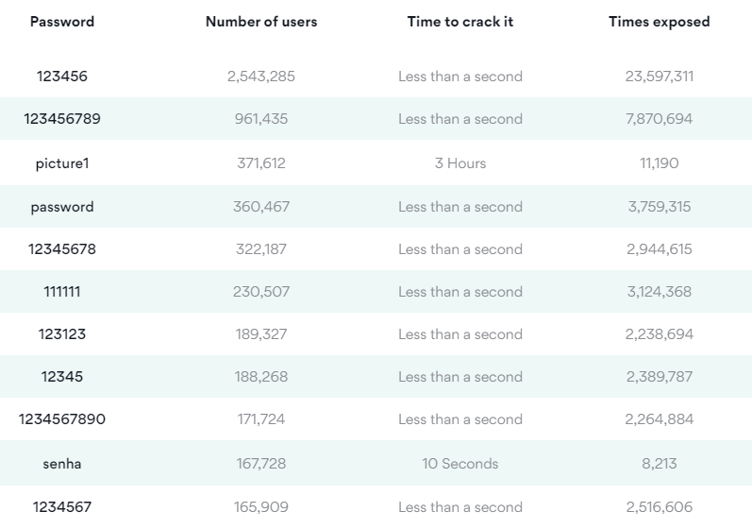
Common Threats – Choice of Passwords

Slide 10
Common Threats - Ransomware
Usually locks screen
Threatens with false accusations in harvesting illegal content
Requires some form of payment to gain access back to your data.

Slide 11
Common Threats - Phishing
Is the fraudulent attempt to obtain sensitive information by impersonating oneself as a trustworthy entity in digital communication.

Slide 12
Common Threats – DDOS (Distributed Denial of Service Attack)
The act of cramming or flooding an incoming traffic from many sources to make impossible to legitimate traffic to pass through .

Slide 13
The cost of not reporting breaches - GDPR
2% of your global turnover or $12,000,000 USD according to article 58

Slide 14
Encryption
Hashing
In Transit
TLS (Transport Layer Security)
Symmetric 1 key
Asymmetric 2 keys (Private and Public Keys)
At Rest
Bitlocker
TDE (Transparent Data Encryption)
Digital Signature Assurance
Can’t convert back

Slide 15
Azure Security Center

Slide 16
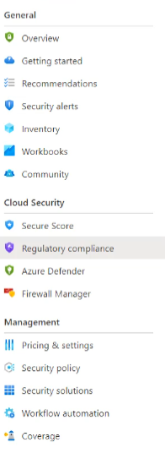
Azure Security Center
Free of Charge
Monitoring service for On Premises and in the Cloud
Log Analytics Agents for Windows and Linux
It is for VMs as well as PAAS systems
Notes:
TODO

Slide 17
Cloud Security
TODO
Notes:
TODO

Slide 18
Community Repository
TODO
Notes:
https://github.com/Azure/Azure-Security-Center

Slide 19
Azure Defender

Slide 20
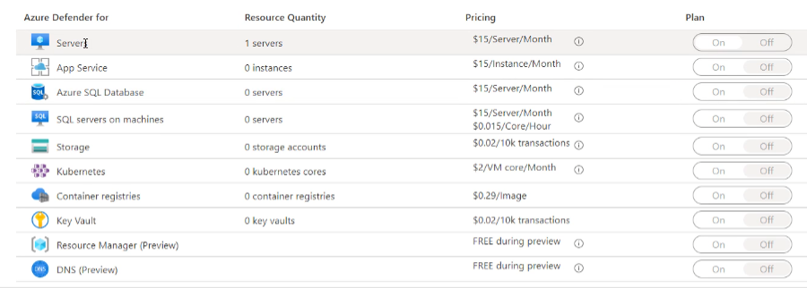
Azure Defender
Paid option
VM Vulnerability Assessment
Just in Time VM Access
Adaptive Application Control
Container Image Scanning
Adaptive Network Hardening
SQL Vulnerability Assessment
File Integrity Monitoring
Network Mapping
IoT Security

Slide 21
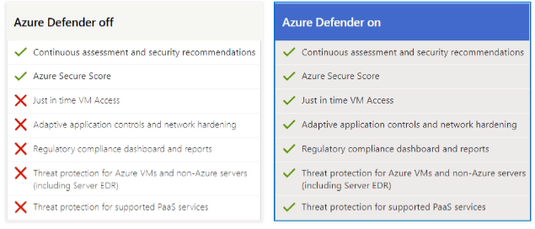
Azure Defender

Slide 22
CSPM Philosophy
Cloud Security Posture Management
Considering Zero Trust Security Model
Considering App Risk Scores
Considering TVM (Threat & Vulnerability Management) for totality of the entire attack Service
Considering the Threat Model Tool

Slide 23
The Concept of SIEM, SOAR and XDR

Slide 24
Log Analytics

Slide 25
Log Analytics
TODO
Notes:
The ? Mark is the knowledge center

Slide 26
Log Analytics – Tiers/SKUs
TODO
Notes:
The ? Mark is the knowledge center

Slide 27
Azure Agents
TODO
Notes:
The ? Mark is the knowledge center

Slide 28
Solutions
TODO
Notes:
The ? Mark is the knowledge center

Slide 29
Thank You slide
Break

Slide 30
Welcome Back!
7:00-7:05 | Welcome
7:05-7:15 | Keynote
7:15-7:45 | Demo Walkthrough
7:45-8:00 | Break
8:00-9:00 | Data Loading & Data Lake Organization
9:00-10:00 | Activity: Data Lake Design & Security Considerations | Table Group Call
10:00-10:15 | Break
10:15-11:00 | Build Hands-on: Data Integration Part 1 | Table Group Call
11:00-12:00 | Break | Main Call
12:00-12:30 | Data Transformations
12:30-13:00 | Activity: Data Engineering Discussion | Table Group Call
13:00-14:00 | Build Hands-on: Data Integration Part 2
14:00-14:15 | Closing | Main Call
Presentation/
Whole Group
Lab
Activity/ Discussion/ Group Work
Announcements

Slide 31
Azure Defender Solutions

Slide 32
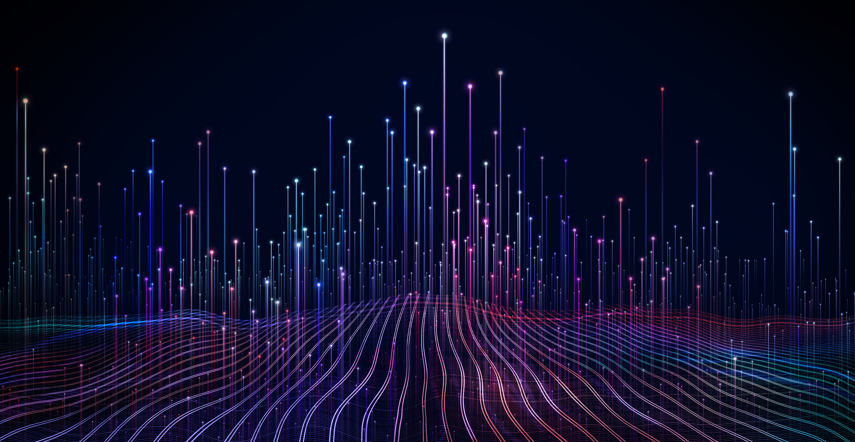
Agenda
1 Azure Defender Solutions
TODO
2 Best Practices
TODO

Slide 33
VM + SQL Vulnerability Assessments

Slide 34
Azure Defender – VM Vulnerability
TODO

Slide 35
Qualys Scanner
TODO
Notes:
Qualys Terms:
https://ascva.blob.core.windows.net/vadocs/ASC-Qualys-%20EULA.pdf

Slide 36
Azure Defender – SQL Vulnerability
TODO

Slide 37
File Integrity

Slide 38
File Integrity
TODO

Slide 39
Pop Quiz
Which one of these is NOT a component of a Synapse pipeline?
A) I.R.
B)
Linked Service
C)
Table
D) Activity

Slide 40
Container Image Scanning

Slide 41
Container Image Scanning
TODO

Slide 42
Adaptive Application Control
Notes:
Back to me

Slide 43
Adaptive Application Control
TODO

Slide 44
Adaptive Network Hardening
Notes:
Back to me

Slide 45
Adaptive Network Hardening
TODO

Slide 46
Just In Time VM Access
Notes:
Back to me

Slide 47
JIT VM Access
TODO

Slide 48
Network Map
Notes:
Back to me

Slide 49
Network Map
TODO
Notes:
The ? Mark is the knowledge center

Slide 50
IoT Security
Notes:
Back to me

Slide 51
IoT Security
TODO
Notes:
The ? Mark is the knowledge center

Slide 52
Best Practices

Slide 53


Question…
How many different methods of loading ADLS can you think of?
What about a Synapse SQL Pool?

Slide 54
Best Practices
TODO
Notes:
The ? Mark is the knowledge center

Slide 55
Session and Lab Environment

Slide 56
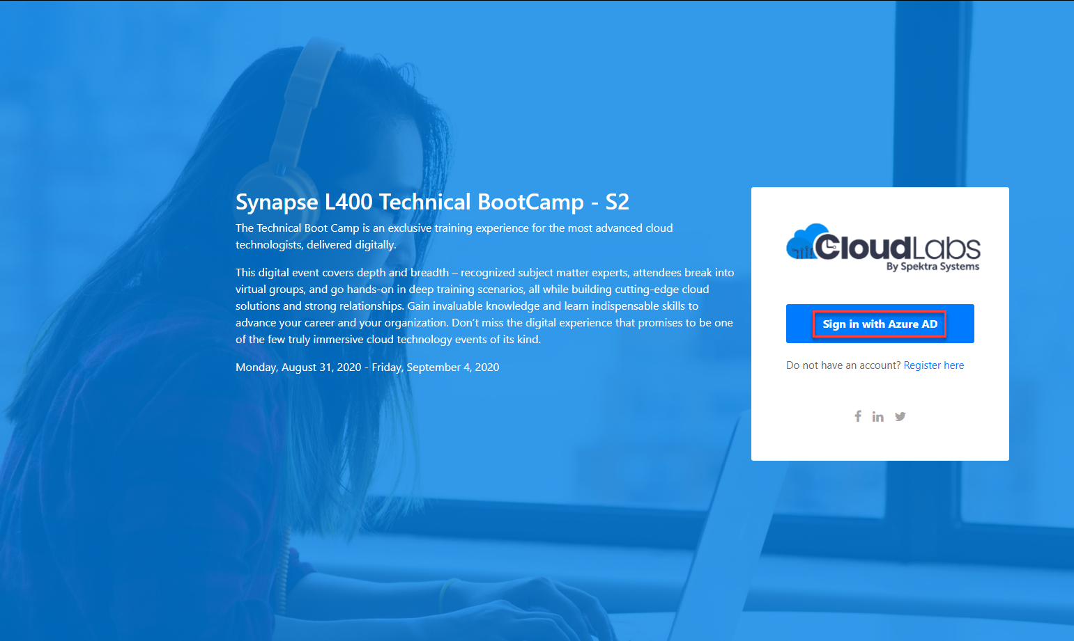
Login to the portal
Notes:
If they don’t have the emails.
Register link: https://bit.ly/32qwla3
Activation Code: ACTIVATE13799

Slide 57
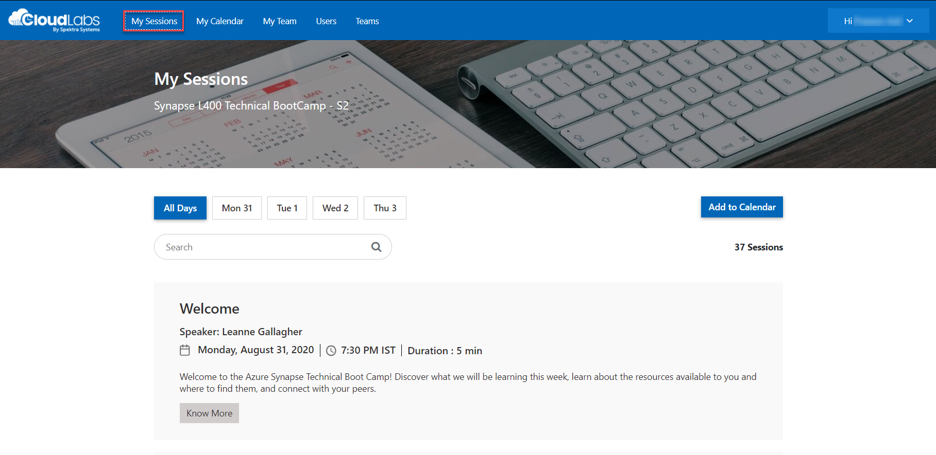
Sessions for Bootcamp

Slide 58
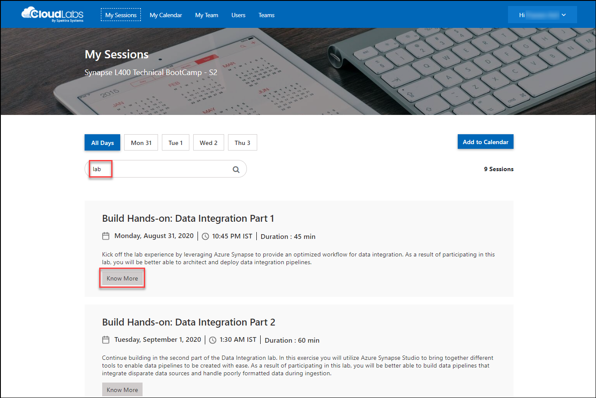
Search for lab
Search for lab
Click on Know More

Slide 59
Thank You slide
Break

Slide 60
DEMO: How to whiteboard designs

Slide 61
Breakout Activity: Data Lake Design & Security Considerations
As a result of participating in this activity, you will better be able to design, optimize and secure a file system within ADLS Gen2.
OUTCOMES
ACTIVITY
60 minutes
Learning Adviser
Table Group Channel
As a team review WWI requirements provided in student guide
Open the whiteboard and as a team answer the provided challenge questions.
The questions are pre-loaded into the whiteboard.
Welcome | Keynote | Demo Walkthrough | Break | Data Loading & Data Lake Organization | Activity: Data Lake Design & Security Considerations | Break | Lab: Data Integration Part 1 | Break | Data Transformations | Activity: Data Engineering Discussion | Lab: Data Integration Part 2 | Closing

Slide 62
DEMO: How to access your lab environment

Slide 63
Build Hands-on Lab: Azure Defender Part 1
As a result of participating in this lab, you will be better able to deploy azure defender protections
OUTCOMES
ACTIVITY
60 minutes
Independent
Table Group Channel & CloudLabs Environment
Independently review and complete Exercises 1-4 in the Lab 1 Guide.
Login to your CloudLabs environment and work through a set of tasks you would typically follow in work associated with ingesting and integrating your customer’s data.
The Lab Guide is available in the ‘Files’ tab of the General channel. Engage your Table Group call for support and troubleshooting.
Welcome | Keynote | Demo Walkthrough | Break | Data Loading & Data Lake Organization | Activity: Data Lake Design & Security Considerations | Break | Lab: Data Integration Part 1 | Break | Data Transformations | Activity: Data Engineering Discussion | Lab: Data Integration Part 2 | Closing

Slide 64
Welcome Back!
8:00-8:05 | Welcome | Main Call
8:05-8:15 | Keynote
8:15-8:45 | Demo Walkthrough
8:45-9:00 | Break
9:00-10:00 | Azure Defender File Integrity + Container Image Scanning
10:00-10:15 | Break | Table Group Call
10:15-11:15 | Azure Defender Adaptive Application Control + Adaptive Network Hardening
11:15-12:15 | Build Hands-on: Azure Defender Part 1
12:15-1:15 | Break | Main Call
1:15-2:15 | Azure Defender VM/SQL Vulnerability Assessments | Main Call
2:00-3:00 | Activity: Data Engineering Discussion | Table Group Call
3:00-4:00 | Build Hands-on: Azure Defender Part 2
4:00-4:15 | Closing | Main Call
Presentation/
Whole Group
Lab
Activity/ Discussion/ Group Work
Announcements

Slide 65
Thank You slide
Thank you

Slide 66
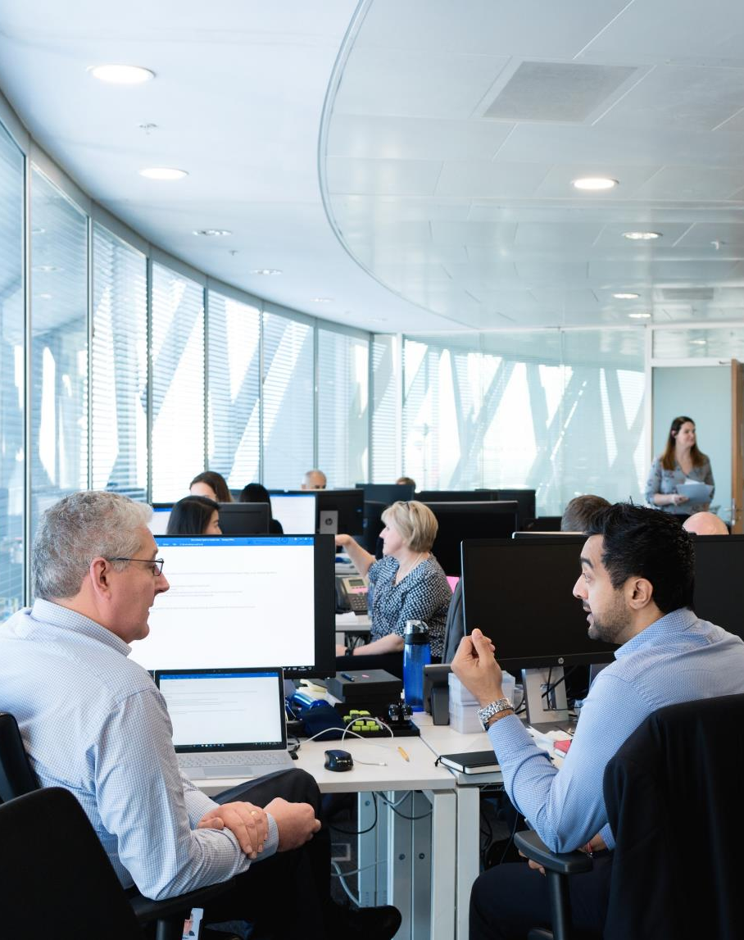
Full Group Activity: Azure Defender
Objective: As a result of participating in this activity, you will better be able to TODO.
What you will be doing: The facilitator will be posting questions to the entire group using an interactive tool called Mentimeter. The answers you post using Mentimeter will then drive the discussion.
Total Activity Time: 30 minutes

Slide 67
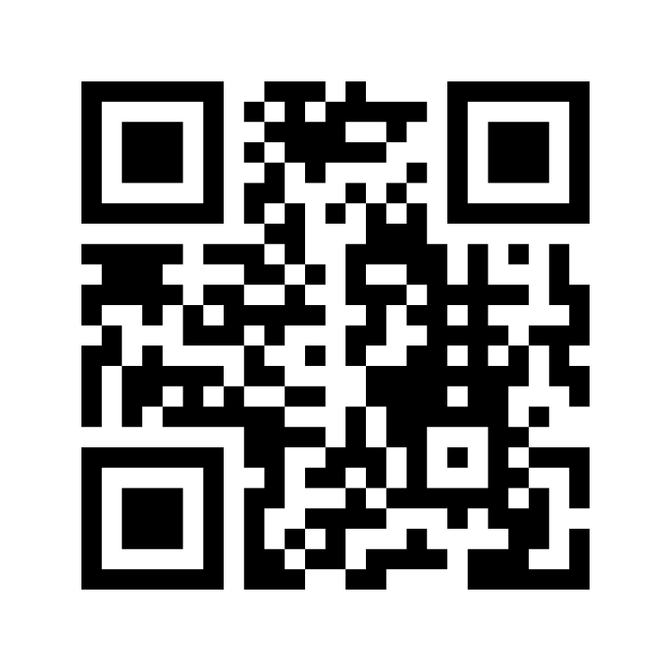
Mentimeter Poll
Scan QR Code
or Go to www.menti.com and use code
1183 9575
Notes:
https://www.menti.com/9r2wwujwag

Slide 68
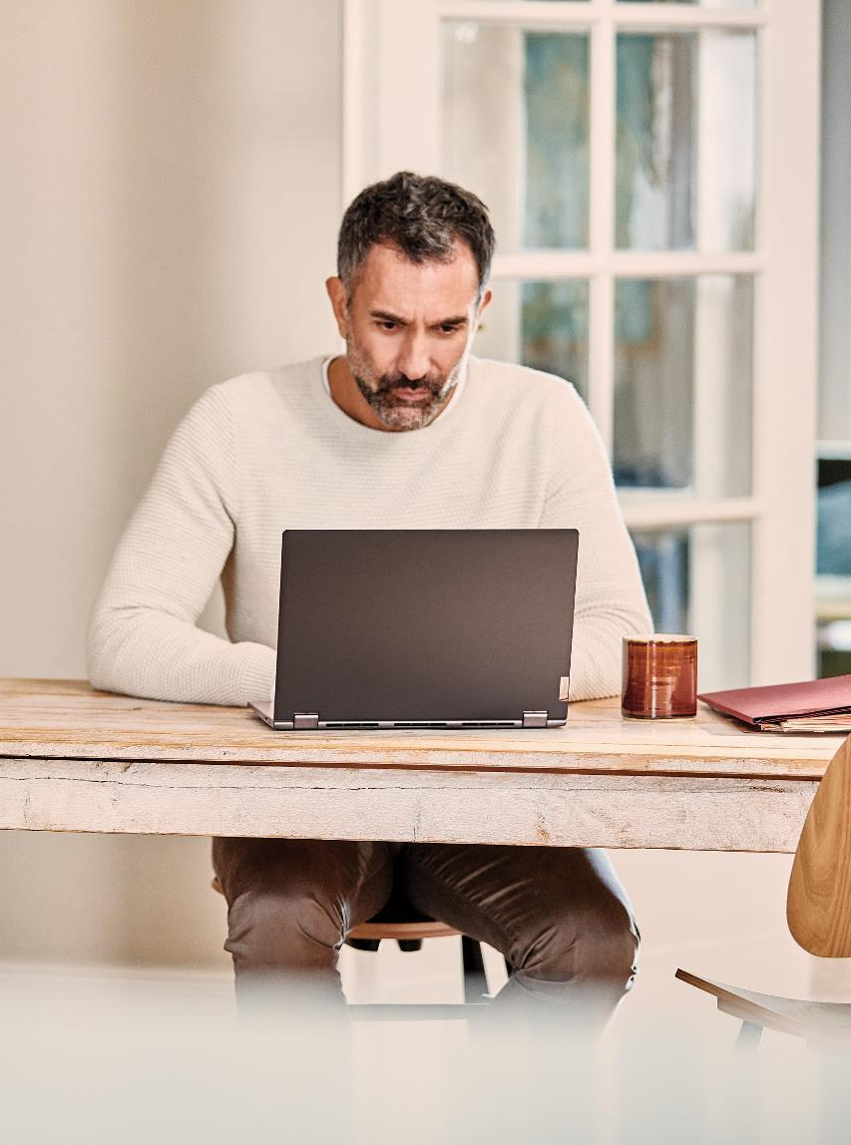
Hands-On Build Activity: Azure Defender Part 2
Objective: As a result of participating in this lab, you will be better able to TODO.
What you will be doing: Like the Part 1 exercise, you work individually in your lab environment to complete a set of tasks you would typically follow in work associated with ingesting and integrating your customer’s data. A set of tasks are outlined for you to follow and complete.
Total Activity Time: 60 minutes

Slide 69


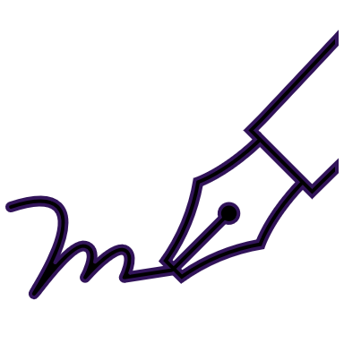






Lab: individual lab exercise
Step 1: Go to your table group channel
Step 2: Your Learning Adviser will provide you a unique cloud lab login link
Step 3: Login and begin the lab. Engage your table group via a Microsoft Teams “meet now” call to support each other (meet now button in upper right corner of application)

Slide 70
Closing
Thank you for your participation in today’s Azure Synapse Technical Boot Camp!
We learned:
File Integrity
Adaptive Application and Network Hardening
VM and SQL Vulnerability Assessment
Container Instance Monitoring
TODAY
We will learn to:
Azure Sentinel
Azure Sentinel + Azure Defender
TOMORROW

